Slide 1
Pfizer execute script

Slide 2
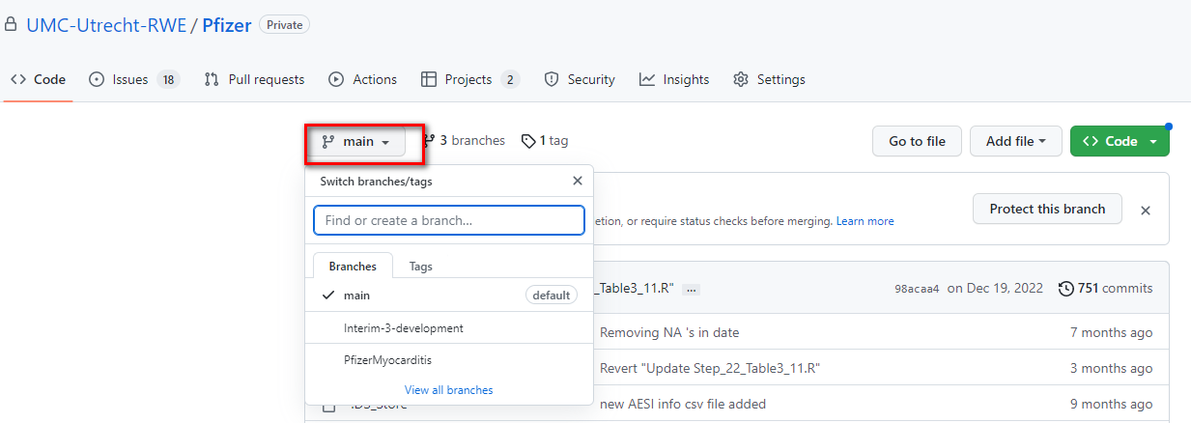
How to get the script (1)
Go to https://github.com/UMC-Utrecht-RWE/Pfizer
If you have no access please contact the study team
Switch to the correct branche
Ask study team which branch to use

Slide 3
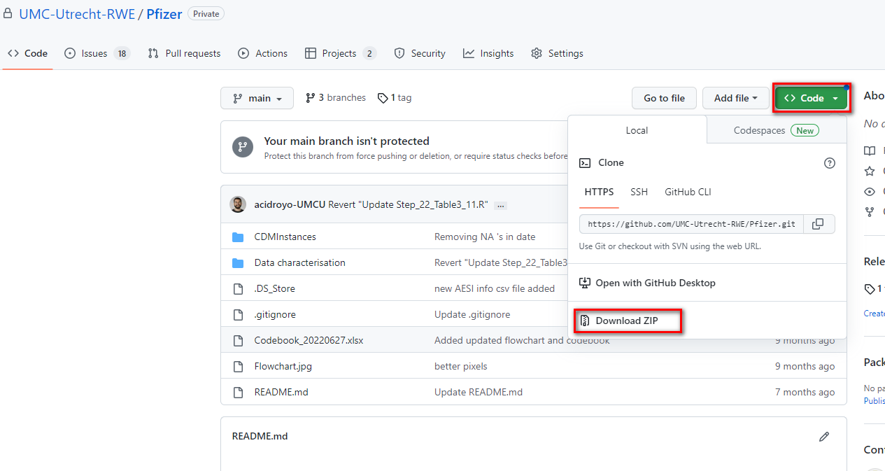
How to get the script (2)
Download and unzip the zip file to a folder of your choice on your computer/server
Note that changes in the script are not updated after you download the zip file. So if changes were made in the downloaded branch, you need to redo the download before running.
Alternatively, you can use GitHub desktop in which it is easier to synchronize changes made in the branch. https://desktop.github.com/. (this description is not covering how to work using GitHub)

Slide 4
Folder structure script
CDMInstances
TEST_SAMPLE -> sampled CDM ARS
Validate -> sampled CDM original used as regression test
…. -> add here a folder with the CDM of interest
Data characterization
PfizerScript
g_intermediate
Concepts -> place where all the concepts are stored. In the concepts.db file and for matching as intermediate .rds files
populations -> D3 output and the matching intermediate database
AESI -> .rds files with per adverse event of interest (AESI) the nearest dates compared to T0 (prior and post)
matching -> matching.db file, intermediate .rds files (_SPELLS) needed for the creation of matching.db and DIC_ .rds files to translate data from integer values
propensity -> outcomes from the IPW which is an intermediate product of the D4
tmp -> Result of the preparation, which is the study population and cleaned meta information. Also the eventually dictionary relevant for D4
Vaccins -> cleaned covid vaccine overview.
g_output -> DAP relevant csv files
p_meta_data -> study information needed for the script: see Pfizer readme p_meta
TableFormats -> information needed for the creation of the table shells
p_steps -> source code
Functions -> functions used in the script
Not relevant for prematch -> old scripts/code and script to sample data.

Slide 5
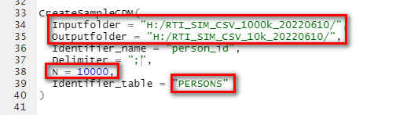
Advise: first run on sample
Because a run on full data can take a day, it is advised to test/try the following steps first on a sample of the data. In the folder \CDMInstances you can find the script Take_sample.R. On row 35 of that script the path to the CDM needs to be specified under Inputfolder. On row 36 the new path of the sample should be specified under Outputfolder. If you run the script a sample of 10000 subjects will be written to the specified Output folder.
The size of the sample is by default 10.000, but can be changed at row 38.
The sample size can affect the number of matches found in the script and rare events can be missed due to a small sample size.
The sampling assumes that there is a file named PERSONS.csv. If suffixes are used, by example PERSONS_1.csv + PERSONS_2.csv, then at row 39 you need to change the Identifier_table to PERSONS_1. Choose the table with most subjects as Identifier_table.

Slide 6
Which preparations are expected
Run level 1 -> continue if all issues are solved
Run level 1b -> upload results to anDRE
Run level 2 -> continue if all issues are solved
Run level 3 -> continue if all issues are solved
Make a new folder in /CDMInstances and copy the CDM .csv files to this folder*
Check /p_meta/additional_concepts.csv. See Pfizer readme p_meta section 2.2.1
Check /p_meta/Pfizer_dictionary.csv.csv. See Pfizer readme p_meta section 1.3
*If you not want to copy the files you can also not do this step and specify the path to the CDM csv files. This is explained later. Moreover, it is assumed that in this folder only
CDM relevant csv files are stored.

Slide 7
Which scripts to run in R studio in which order
Developer
DAP (no prematch*)
DAP (prematch*)
to_run_development
to_run
to_run_prematch
/g_output/SUBJECTS_TO_EXTRACT.csv
to_run_after_event_extraction
to_run_t4_new
*prematch: first the matching is applied on a CDM that is restricted to data that is needed for the matching. Then, for privacy reasons, only for the subjects that are exposed or a match to an exposed,
the rest of the needed data is extracted and added to the folder that contains the CDM csv files. Note that it is assumed that the added files do not overlap with the data that is already in the other files.

Slide 8
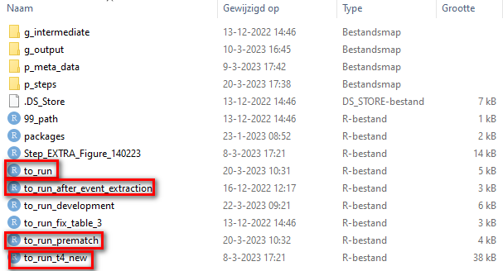
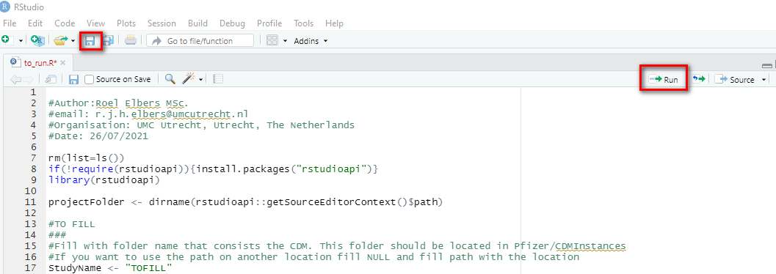
How to use R Studio to execute the script
Make sure R studio is installed on your computer: https://support--rstudio-com.netlify.app/products/rstudio/download/
Open the needed to_run script (see previous slide) by double clicking on the script in \Data characterisation\PfizerScript
Set the parameters as instructed on the next sheet
Save the changes by pressing the blue disk icon
Run the script by selecting all text in the script (control + A) and press run
If errors stopping the script please check first the often occurring errors, that you can find two slides after this slide.

Slide 9



Which parameters to set at to_run
In R you can declare a variable by using <- followed by a string in quotes. This needs to be done for several variables that are found in the to run scripts.
DAP: fill the correct database name ("TEST","CPRD","ARS","SIMG","PEDIANET","SIDIAP","EPICHRON","UOSL“ or "PHARMO")
path or StudyName: if you copied over the folder into CDMinstances then use StudyName. If you did not do that use path. Set NULL to the variable not used.
preg_dir: fill the path to the folder where the output from the pregnancy algorithm is filled
start_study_date: date of first vaccination in your country as “YYYYMMDD”
end_study_date: the date of running the script for end_study_date “YYYYMMDD”
OR

Slide 10
Often occurring errors stopping the script
Incorrect path or folder name (case sensitive)
Correct the path or folder name
Covid vaccination not found
/p_meta/additional_concepts.csv not filled correctly (case sensitive)
Dates empty or not in valid format
Invalid coding system names in the events table
Check the CDM csv tables. If making an issue always provide screenshots proving how the covid vaccinations is in your csv files.
A CDM column name or table not found.
They are simply not there and should be added/corrected.
Disk is full. This can happen during matching simply because the disk is full.
Free disk space in the disk where temporary files are stored. This is not necessarily the disk where the script is saved. Run tempdir() in R to check which disk is full.
If not possible to retrieve more disk space use the loop method instead of SQL. This is achieved by changing the variable MATCHING_METHOD 1 row before Step_09_MatchingProcedure.R,. This is done by adding and saving MATCHING_METHOD <- "LOOP“ to the script 1 row prior to system.time(source(paste0(pre_dir,"Step_09_MatchingProcedure.R"))).
If making an issue always provide the \Data characterisation\PfizerScript\g_intermediate\populations\Matching\MATCHING_STATS.rds file
Problems with hard coded DAP specific codes.
This should be prevented in the future
PHARMO has free_text added to the code sheet which does recurrently gave problems
CPRD added it’s own coding system in which also categorical information is added which is not valid
Errors/warnings in Step_12_AddCoVariates
In this script the warning gives additional information. Please make a screenshot of this and provide this together with the needed files that are mentioned in the warning.

Slide 11
How to open intermediate files
There are 2 types of files stored during the script in \Data characterisation\PfizerScript\g_intermediate. These files can be opened and reviewed as follows:
.rds files: open R studio -> file -> open -> browse to file -> double click > click ok in the Load R Object window.
.db files: this are database files containing multiple tables. These can be reviewed using db browser https://sqlitebrowser.org/dl/. After downloading see the following link as instruction: https://datacarpentry.org/sql-socialsci/02-db-browser/index.html

Slide 12
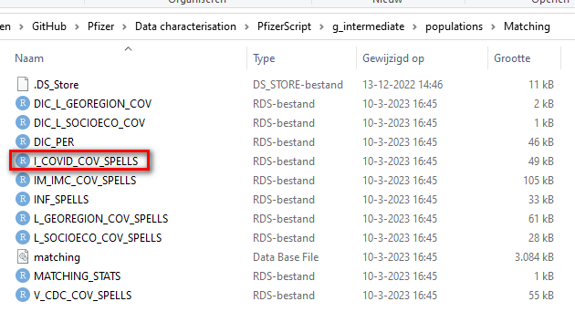
Checks after to_run/to_run_prematch (1)
In \Data characterisation\PfizerScript\g_intermediate\populations\Matching check which _SPELL files are available. For every matching factor 1 spell file should be available and contain data. If a matching factor is missing while you would expect this to be available in your data source please check the following things:
Is /p_meta/additional_concepts.csv filled correctly (case sensitive)
Are date columns not empty and in valid format
Valid coding system names in the events table
Check always the CDM .csv tables. If making an issue always provide screenshots proving how the missing matching variable is in your database specific .csv files.

Slide 13
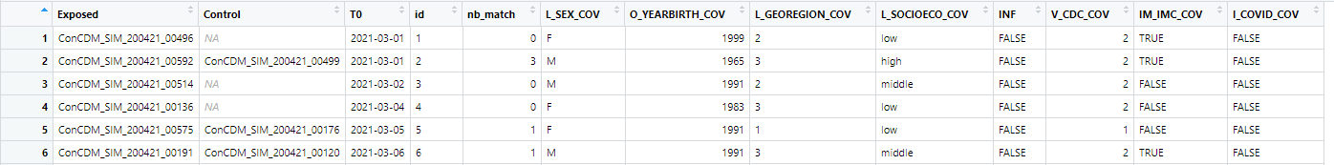
Checks after to_run/to_run_prematch (2)
In \Data characterisation\PfizerScript\g_intermediate\populations the file the file MATCH_PAIRS is saved. This is the result of the matching. Be aware of the following things:
For every spell file of the previous sheet there should be a resembling column.
The number of rows in this file should be approximately equal to the expected number of Pfizer vaccinated subjects in your population. If this number does not resemble expectations please check:
\Data characterisation\PfizerScript\g_intermediate\tmp\FlowChart.rds to get info about the exclusion.
\Data characterisation\PfizerScript\g_intermediate\concepts\COV.rds to see the which covid vaccination rows are extracted from the CDM and if a manufacturer is found.
\Data characterisation\PfizerScript\g_intermediate\vaccins\COV2.rds to see the result of the cleaning and manufacturer imputation process (column NB is the estimated dose number that is used in further steps)
\Data characterisation\PfizerScript\g_intermediate\tmp\PERSONS2.rds is the resulting population for the rest of the script which is a combination of PERSONS.rds and COV2.rds
Note that in a full sample it is expected that only a few missing controls will be seen while in a sample the data there will be a lot of controls with nb_match equal to 0.
If nb_match (possible matches) is high this in general means that the matching process did take long

Slide 14
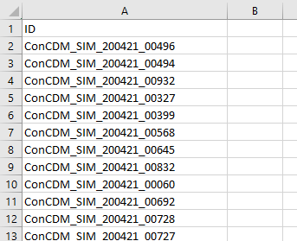
Action needed after to_run_prematch
Only needed if prematch is needed (see flow on sheet 7)
After the checks of the previous two sheets, it is needed to extract additional information from your database and map that to the CDM tables that can be added to the folder where the CDM tables are stored. The following actions have to take place:
Make a back up of the run by saving the Data characterisation/PfizerScript/g_intermediate folder on a separate place.
Go to Data characterisation/PfizerScript/g_output and open the SUBJECTS_TO_EXTRACT.csv file. This contains the subjects that are in the population after matching and from those subject the rest of the data should be extracted.
Map this extracted additional data to valid CDM tables (often EVENTS/MEDICINES)
Add these CDM csv files to the already available tables that where needed for the matching.
Continue the run by running to_run_after_event_extraction
Be aware that changes in the script may occur while the additional data is extracted. Ask the PI when the script is assumed to be ready for production.
Do not extract data that was already extracted before matching.

Slide 15
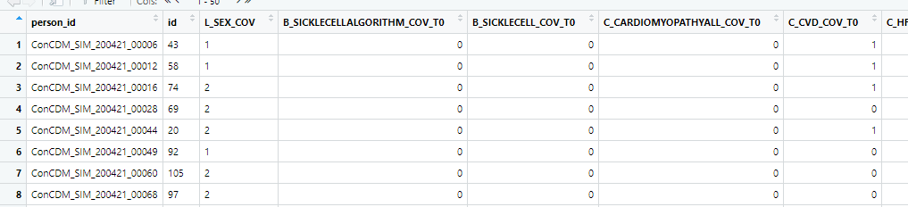
Checks after to_run/to_run_after_event_extraction (1)
Covariates (1)
For the subjects that are still in the study population, and have a T0, the T0 can be related to the concepts that are stored in \Data characterisation\PfizerScript\g_intermediate\concepts\concepts.db. For every concept that is stated as a covariate (as in /p_meta/Pfizer_study_variables.csv column COV) a table needs to be available in the concepts database. The following checks can be performed (see also the next 2 sheets):
Open \Data characterisation\PfizerScript\g_intermediate\populations\M_Studycohort_Covariates_T0.rds. In the columns of this table 0 represents missing. Check which columns only contain 0 values. (this can also be done for M_Studycohort_Covariates_D2 and M_Studycohort_Covariates_D3)
If there are columns with only missing (0) values you can check the following things:
If a table with the resembling table name is available in concepts.db. And if so, how many rows are there in that table.
Check if /p_meta/additional_concepts.csv is filled correctly (case sensitive), or if the codes your database uses are available in the code sheets (see p_meta).
Check always the CDM .csv tables. If making an issue always provide screenshots visualizing how the missing variable is in your database specific CDM .csv file(s).

Slide 16
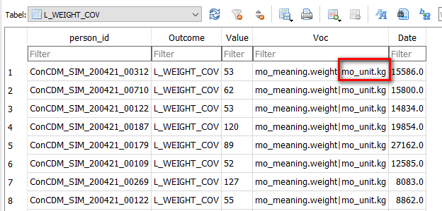
Checks after to_run/to_run_after_event_extraction (2)
Covariates (2)
Open the concepts.db file with DB browser and overview how the tables are populated. In binary (TRUE/FALSE or 0/1) variables, the Value column is not relevant, and can be interpreted in the same manner as the Voc column. Note that, for variables like bmi, weight, height and for some smoke status rows, a valid unit is needed which should be available in the Voc column. This should be specified in p_meta/additional_concepts.csv file (col1-5/val1-5). Valid units are:
BMI: "kg/m2", "kgperm2", "kg/m^2”
WEIGHT: "kg", "kilogram", "kilograms", "kilogramme", "kilo“, "g", "gram","grams", "gramme"
HEIGHT: "m", "meter", "metre“, "cm", "centimeter","centimetre“
Smoke status: cig/day for numerical information (if extracted via a categorical value or a code/coding system combination, the unit is not needed).

Slide 17
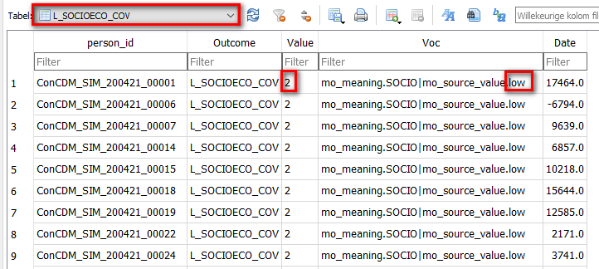
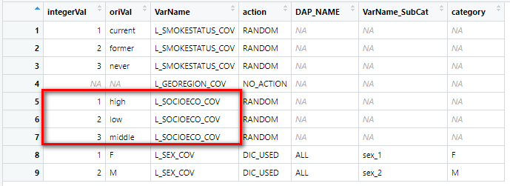
Checks after to_run/to_run_after_event_extraction (3)
Covariates (3)
To enhance performance all categorical data is set to integer. For these variables, the dictionary is needed. Check this via \Data characterisation\PfizerScript\g_intermediate\tmp\Dictionary_result.rds. The column action provides relevant information about choices made by the script Step_11d_ApplyDictionaryIntegers:
RANDOM: no valid dictionary was found so an integer was randomly assigned -> please check if p_meta/Pfizer_dictionary.csv was filled correctly
NO_ACTION: the information found was already in integer, so no conversion to integer was applied
DIC_USED: The dictionary column oriVal did match the content of the extracted data and so the dictionary was used to convert to integer.
Below an example showing how the concepts (left) are connected to the dictionary (right). Note that low is also in the Voc column. This can happen and is depending on how the Pfizer_additional_concepts.csv is filled. In this example “low” was used for the where clause, and in the same row, also as a value to keep. (see Pfizer readme p_meta for an explanation about how to fill the additional_concepts file)

Slide 18
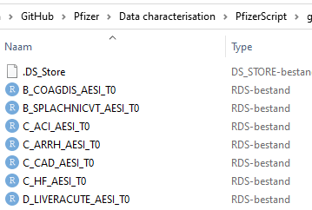
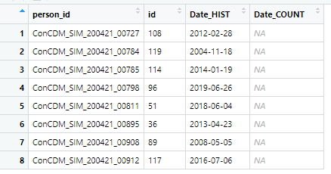
Checks after to_run/to_run_after_event_extraction (4)
Adverse events of interest (AESI) (1)
Next to covariates also AESI’s are created based on T0. Note that these are stored differently. The AESI’s are not stored in 1 file per cohort, but in a separate file per AESI. Moreover, not a boolean or integer value is stored. Instead, the nearest dates are stored prior (Date_HIST) and post T0 (Date_Count).
To check if all expected AESI’s are extracted go to the \Data characterisation\PfizerScript\g_intermediate\populations\AESI folder and see which tables are available. If there tables missing you can check:
Check if a table with the resembling table name is available in concepts.db. If so, check how many rows are there in that table.
Check if /p_meta/additional_concepts.csv is filled correctly (case sensitive), or if the codes your database uses are available in the code sheets (see p_meta).
Check always the CDM .csv tables. If making an issue always provide screenshots visualizing how the missing variable is in your database specific CDM .csv file(s).

